Slide 1

Welcome to Machine Learning Module

Slide 2


Slide 3
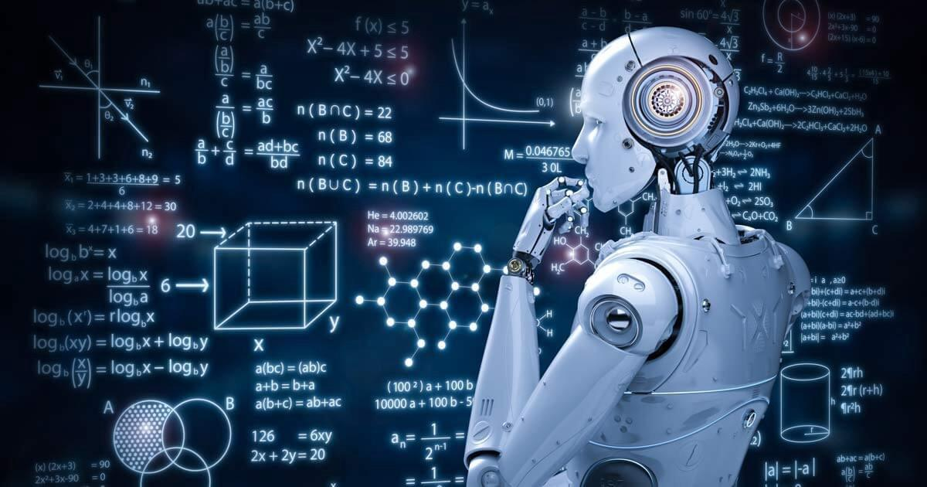
What is Machine Learning?
Different major types
Applications
Key terminology
Applied ML

Slide 4
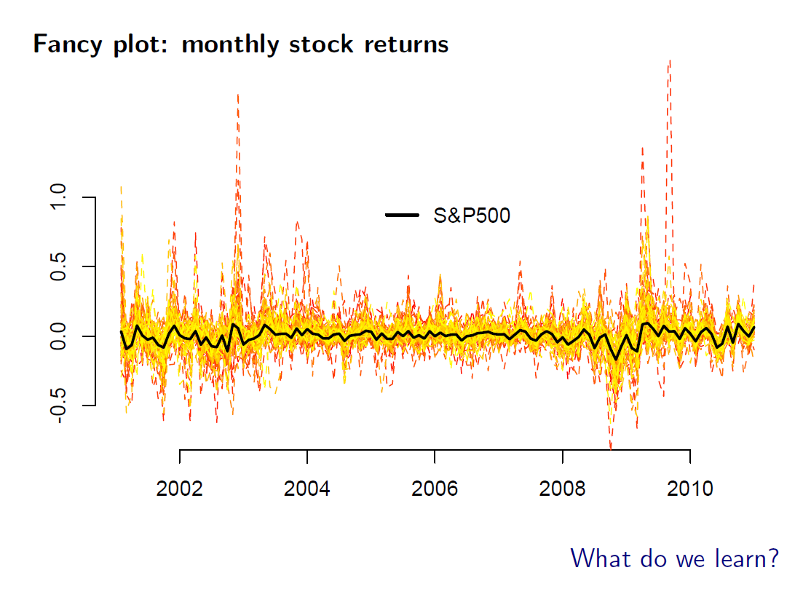

Slide 5
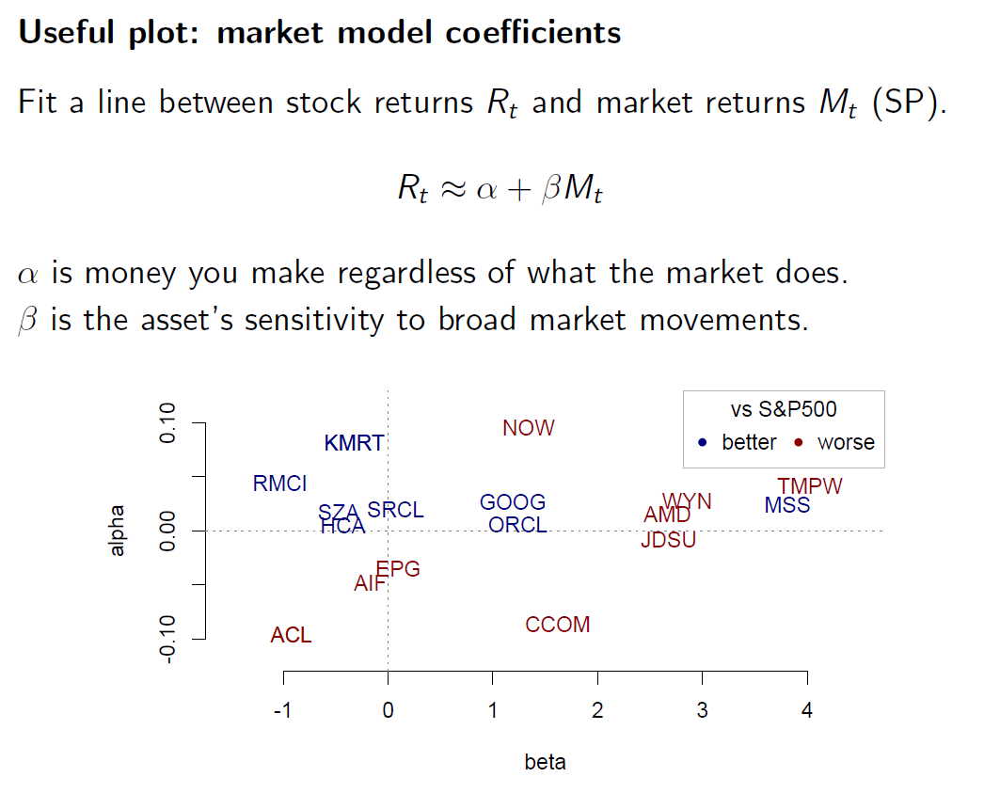
Notes:
Use the board and walk through CAPM. Graph of stock returns and market returns and talk about beta.
This plot is useful because you can make decisions very fast. Find an arbitrage? Pairs trading?
Emphasize that we have a model here CAPM. Now ask what if we don’t have a model? How can we reduce the dimensionality of our messy stock market data?

Slide 6
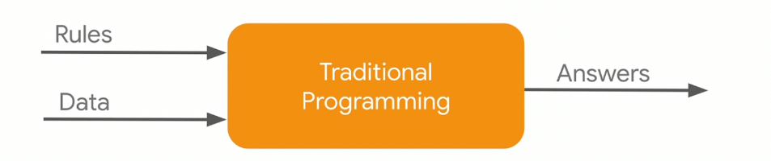
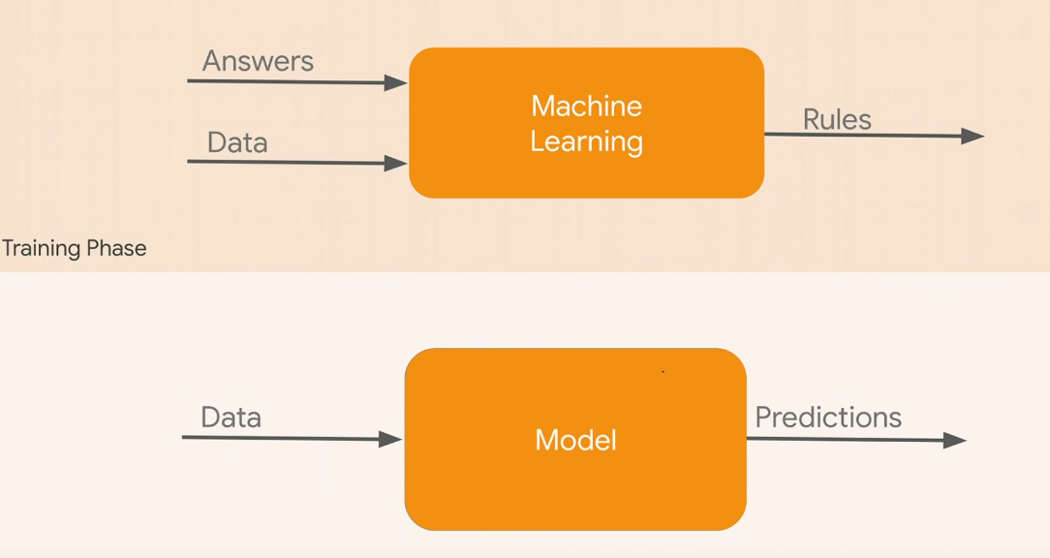
Machine Learning vs. Traditional Programming
Notes:
Give me the f. the rule that links X and y. I want to estimate that.
In statistical learning we do care how does this f look like and if the coefficients are significant (inference).
In ML however we don’t care about f. It is just a blackbox. we just care it if works.
We may use ML to figure out if our model is good or not. BlackRock example.

Slide 7
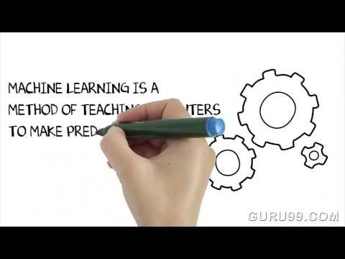
What is Machine Learning?

Slide 8
What is Machine Learning?
Machine Learning is the filed that thinks about how to automatically build robust predictions from complex data.
ML is closely related to modern statistics (many ideas come from statisticians!)
Statistics focus on model inference, ML focus on predictive performance
The entire filed of ML is calibrated against “out-of-sample” experiments that evaluate how well a model trained on one dataset (train data) will predict new data (test data).
While there is a recent push to build more transparency into machine learning, wise practitioners avoid assigning structural meaning to the parameters of their fitted models.
ML models are black boxes whose purpose is to do a good job in predicting a future that follows the same patterns as in past data.
Notes:
Go over bold terms. Automatically… predictions (not interpretation! Or inference). Complex data with high dimensionality. (In this course I will visualize only 2 features though!)
Then go over blue box.
Model inference (understand and interpret the parameters, significance of coefficients and etc)
Predictive performance = black box
If you don’t expect to see same patterns, ML is useless (stock prices, random walk!)
In our previous example CAPM: a statistician wants to make sure that this is a true model and wants to get an unbiased beta (on average hitting at the target). But in machine learning we don’t care about finding the true model, all we care is how close our yhat is to y.
We should use a combination! BlackRock example.

Slide 9
Why you need to learn ML?
To project the information in your data into a low-dimensional space that contains key insights for the decisions you need to make
To give you the tools to quickly turn messy data into useful information that has direct relevance to business policy
Big data + Machine learning = Data science
Big data + Machine learning + Economics/Econometrics= Business data science
Notes:
Big data = data is so big that cannot be saved on 1 machine. So you need to use distributed algorithms (Hadoop and Spark) that can compute data summaries across multiple independent machines.
We shop, talk, share and live on computers and online. Very messy, unstructured and high dimensional.
Business data science: this is where you can/should get strong! And you can out bid the computer scientists out there.

Slide 10
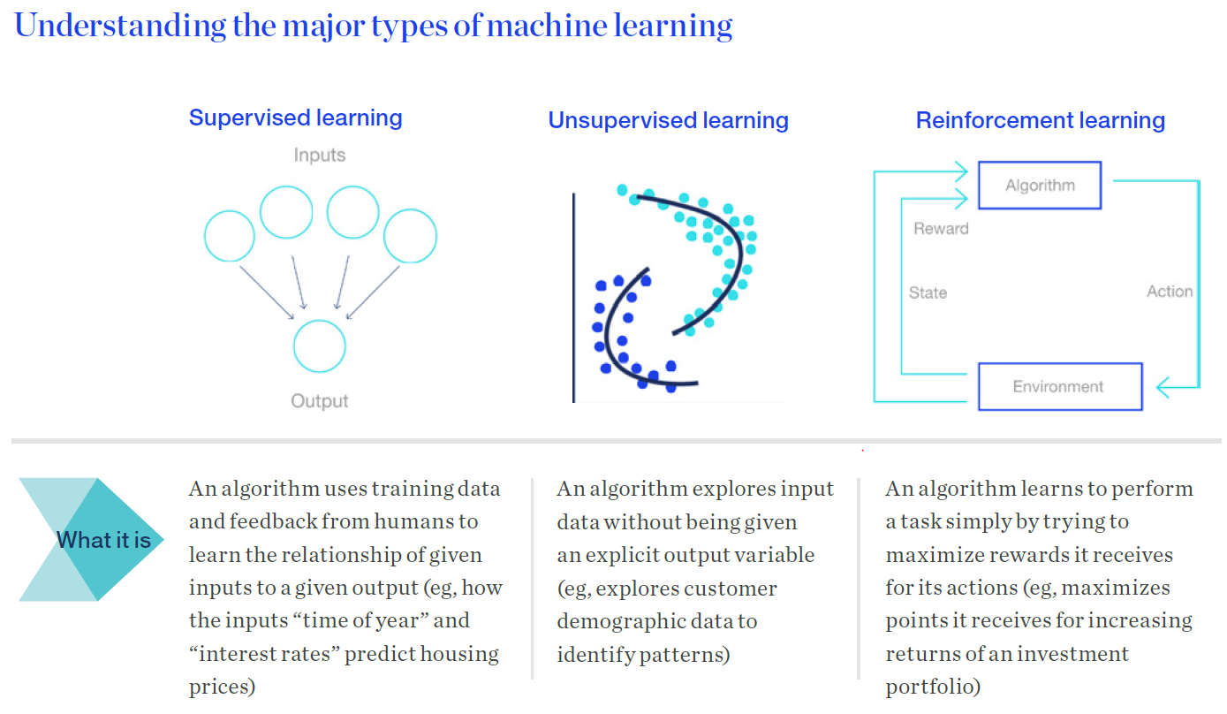
Notes:
The objective in unsupervised is a little fuzzy. find groups of samples that behave similarly, find features that behave similarly, find linear combinations of features with the most variation.
difficult to know how well your are doing.
different from supervised learning, but can be useful as a pre-processing step for supervised learning.
Example for unsupervised: giving some objects to a kid and ask him to organize them! Red and blue triangles and circles.

Slide 11
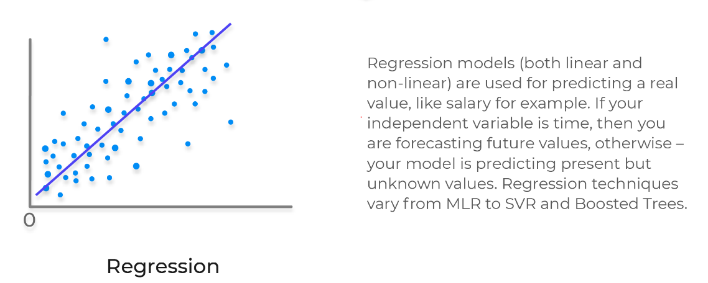
Machine Learning Branches

Slide 12
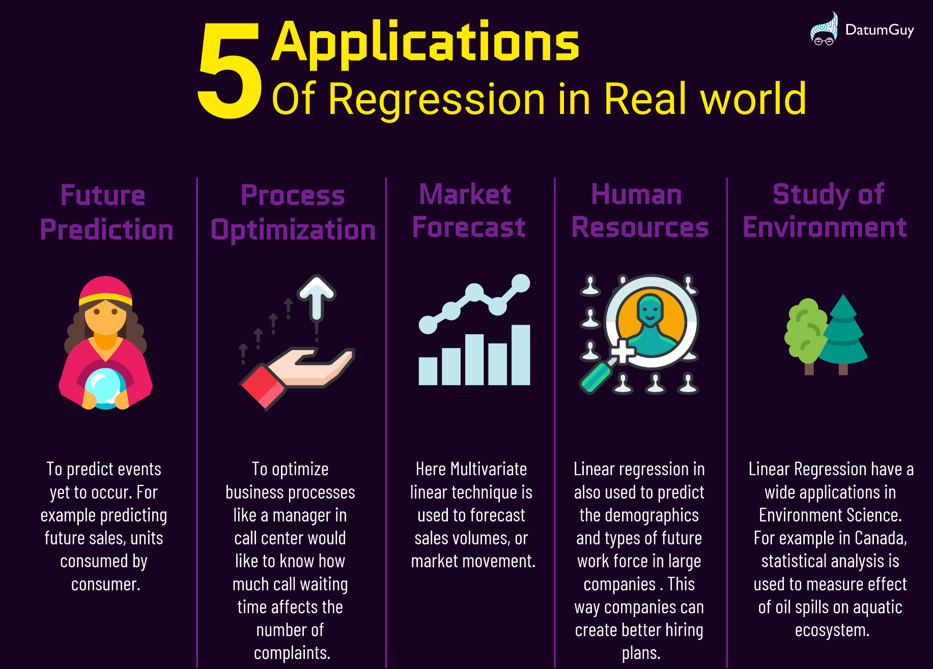

Slide 13
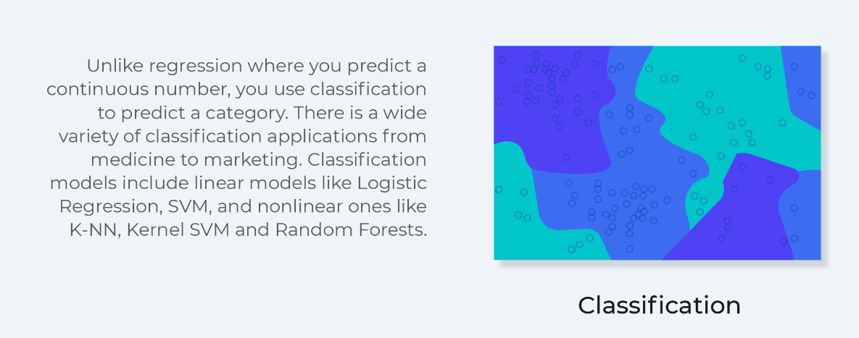
Machine Learning Branches

Slide 14
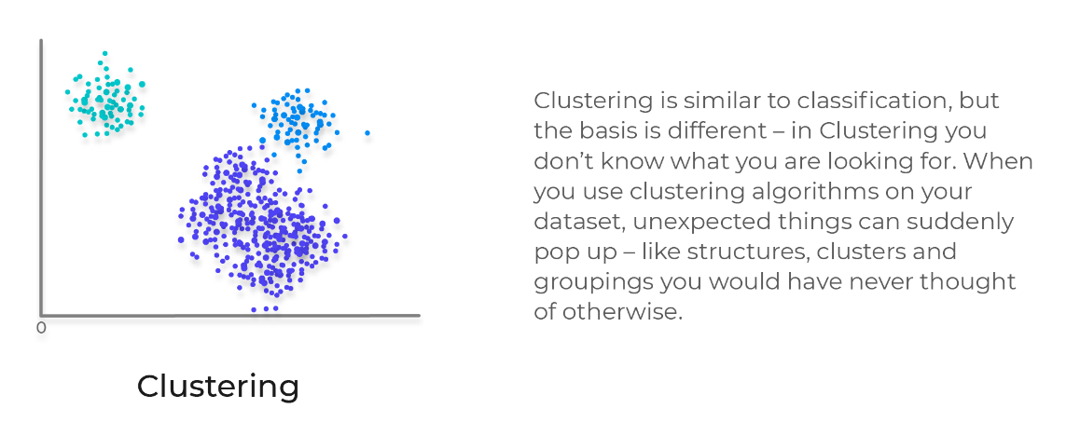
Machine Learning Branches

Slide 15
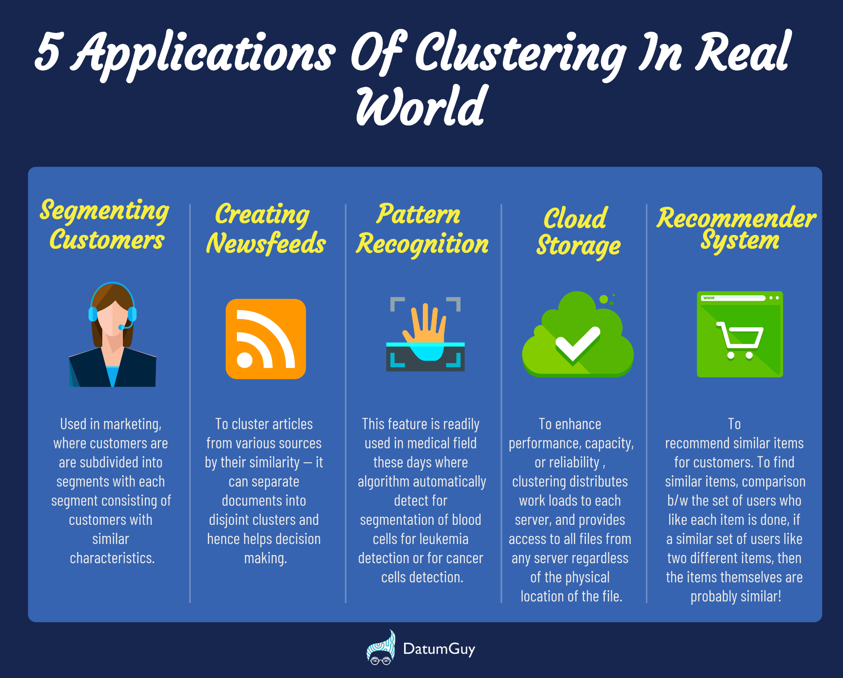

Slide 16
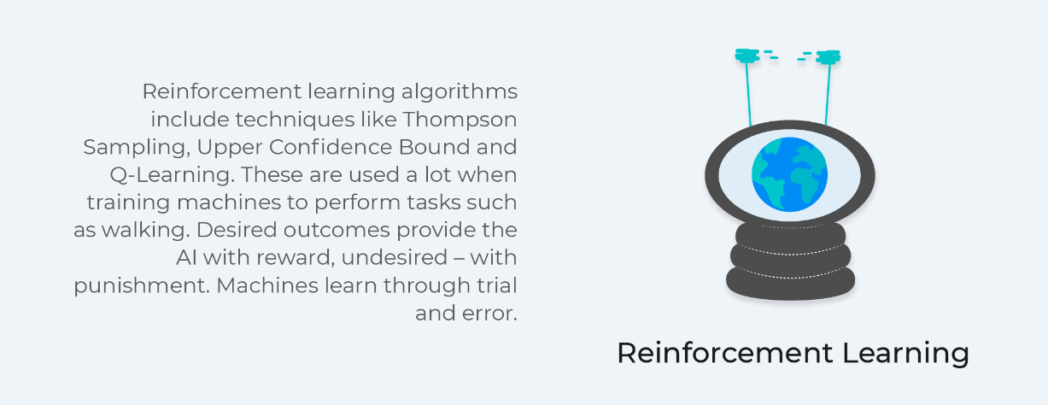
Machine Learning Branches

Slide 17
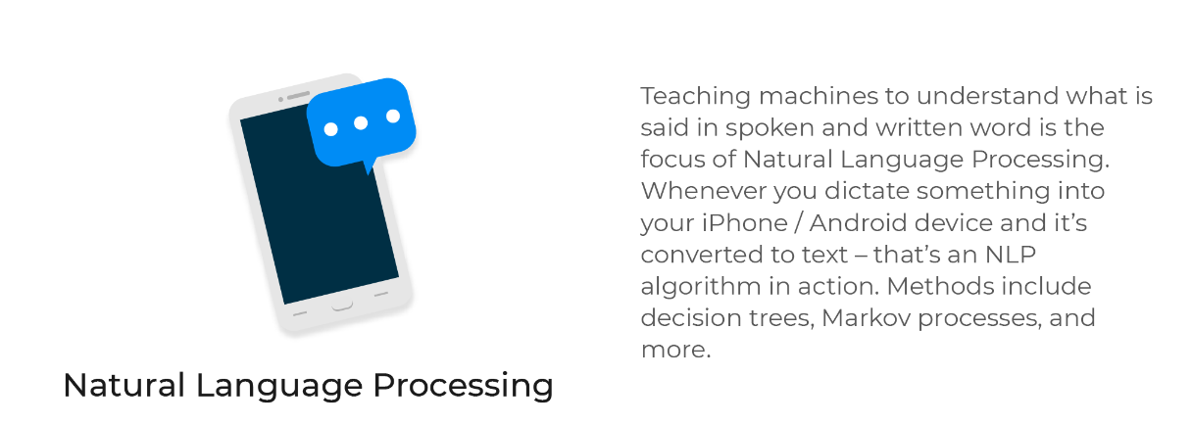
Machine Learning Branches

Slide 18
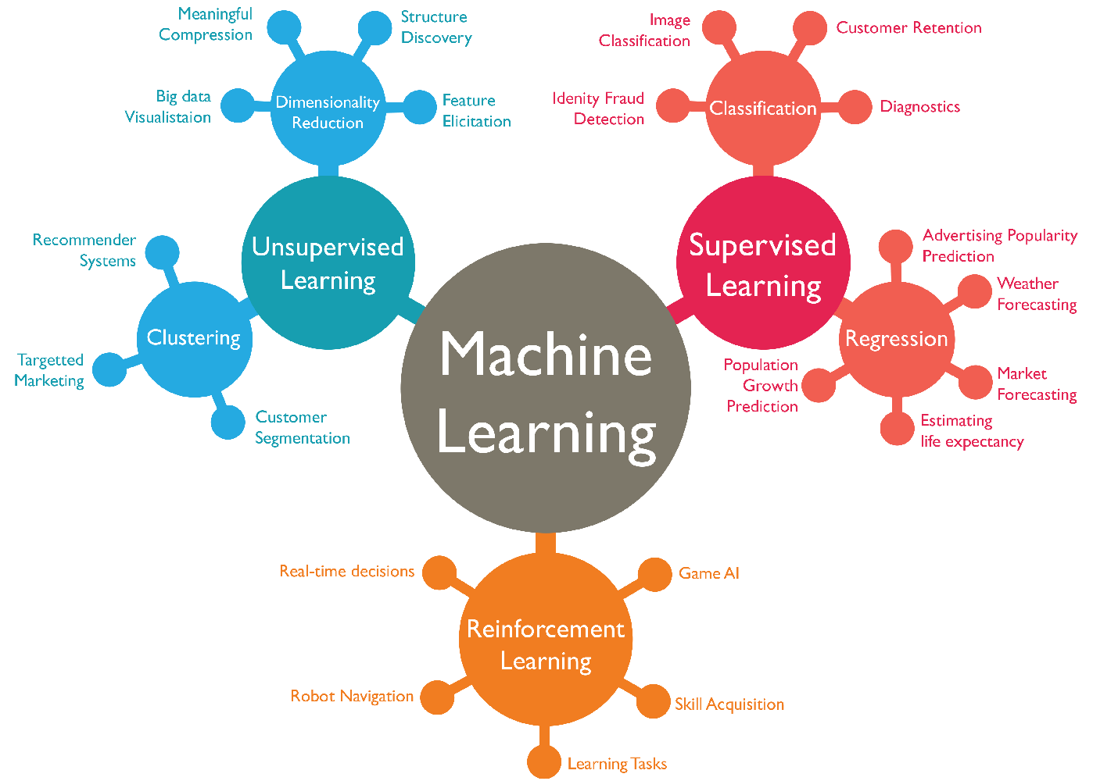

Slide 19

Familiarize you with ML terminology
Prepare you for job interviews
Provide cheat sheets and resources
Help you to hedge yourself against the next recession

Slide 20
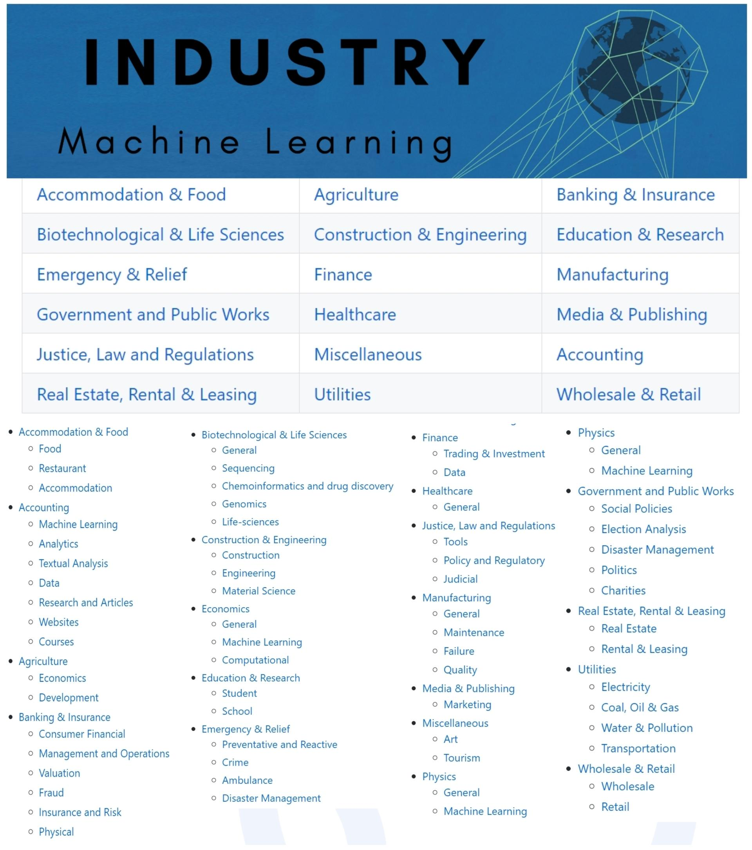
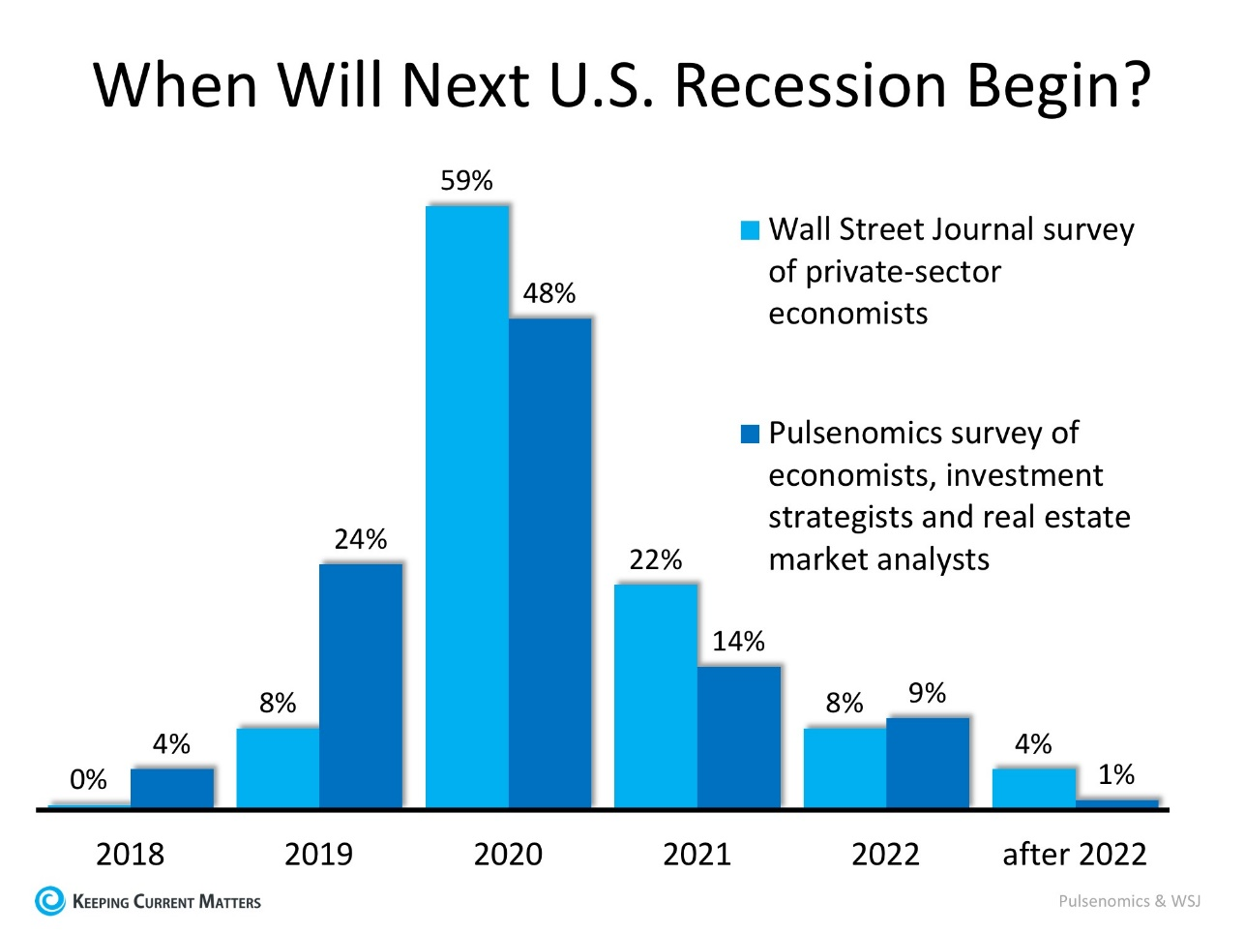
Hedge yourself against the next recession!

Slide 21
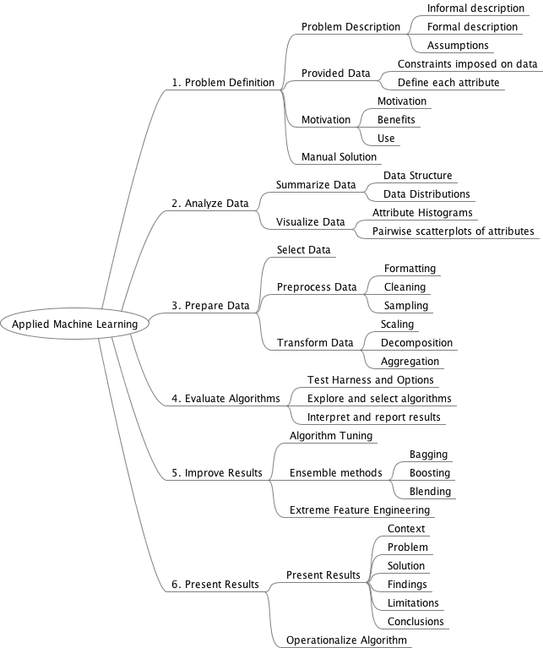
What we learn in this class?

Slide 22

Classes and events

Slide 23
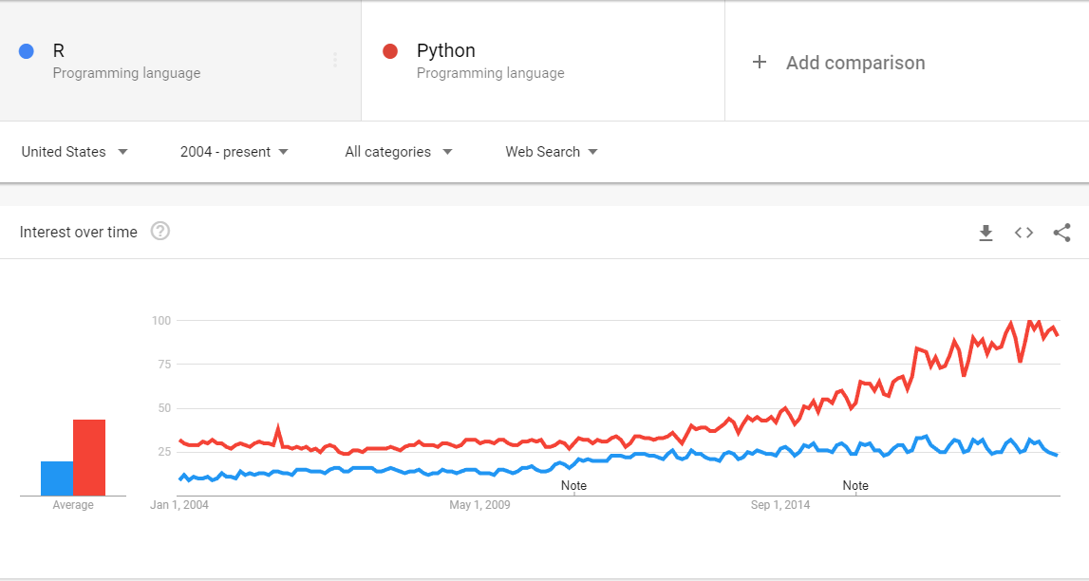
Why Python?
Notes:
For the fundamentals of statistical analysis, R is tough to beat. Look at the leading textbooks (ISLR and business data science)
However, R is not perfect. Python provides a better workspace for many ML applications specially those involving unstructured data like raw text.
For large scale ML you should work with deep learning frameworks like Gluon or Keras.
Scala and HDF slice and aggregate data.
If you work for a big company, most probably you need to learn SQL to pull data from a structured database.
NO language is the best for all purpose. Computing technology is too dynamic for this to be true.
What language is best for learning data science: R
All the methods we learn in this course are scalable.

Slide 24
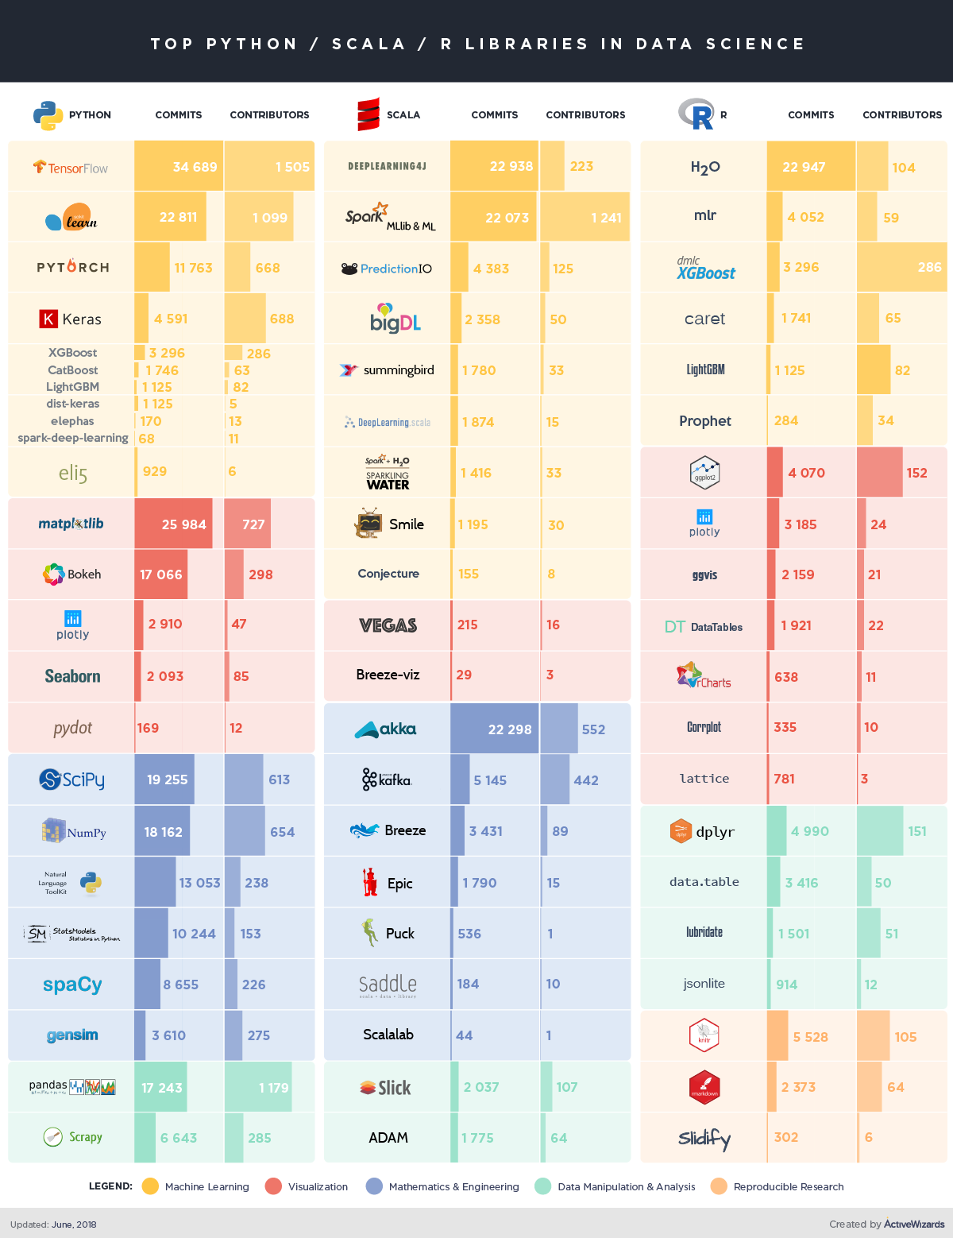

Slide 25

Introduce your self! What project are you working on?

